Slide 1
How to Choose a Model

Slide 2
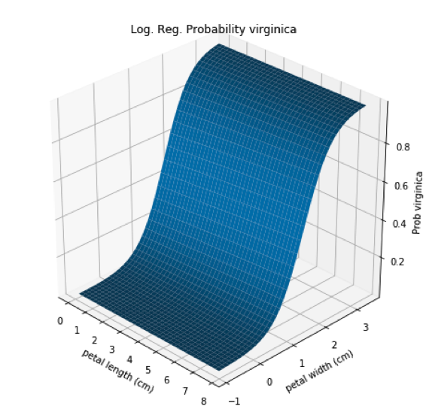
Model Types
White Box
Black Box
Notes:
Photo: https://www.flickr.com/photos/107442568@N08/12547327134

Slide 3
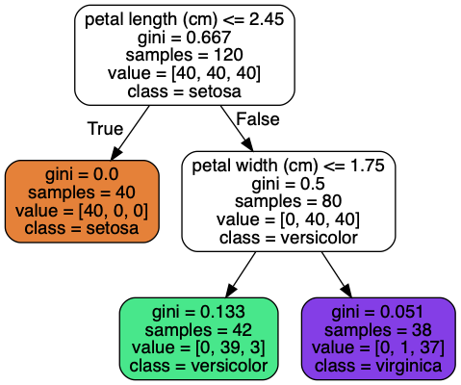
Model Types
White Box
Black Box
Notes:
Photo: https://www.flickr.com/photos/107442568@N08/12547327134

Slide 4
Scikit Learn Map
Notes:
Photo: https://www.flickr.com/photos/107442568@N08/12547327134

Slide 5
Testing several
Pick several models, compare baseline performance of each model
Pick 1-3 best performers, do finer tuning
Continue iteration on final model
Notes:
Photo: https://www.flickr.com/photos/107442568@N08/12547327134

Slide 6
Look to others
Google
Videos
Blog posts
Articles
Github
Research Papers (arxiv, google research)
Notes:
Photo: https://www.flickr.com/photos/107442568@N08/12547327134

